Slide 1
LECTURE 4

Slide 2




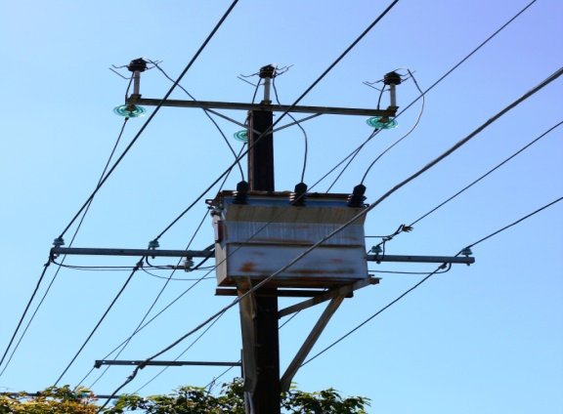
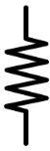
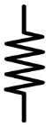
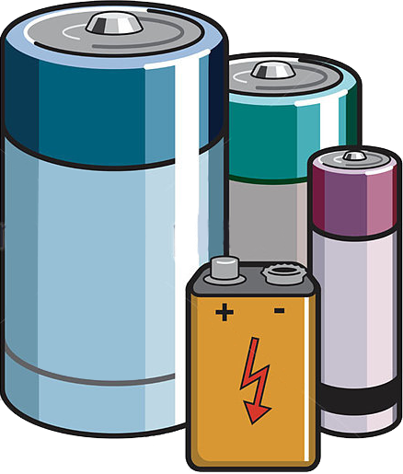
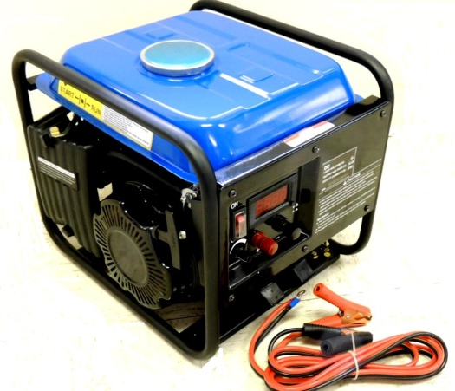

Electric Current
Direct Current (D.C.)
Alternating Current (A.C.)
Battery gives DC current
D.C. generator used in emergency for power supply
Direction of current does not change.
Households mostly get AC current
D.C. current changes its direction 0 times in one second hence its frequency is 0 Hz.
AC current changes its direction 50 times in one second in India.
Hence its frequency is 50 Hz in India
The magnitude and direction of the current is constant.
It represents a sinusoidal wave
or a sine wave
The magnitude and direction of the current reverses periodically.
By using step up transformers it is distributed to households.
This is the symbol of A.C. current
In U.S.A. it is 60 Hz.
AC current starts from one direction reaches its maximum value goes to zero
DC current, starts from positive terminal to negative terminal
After dropping to zero, AC reverse its direction
More is the resistance and hence there is loss of energy
AC current can be connected to step up and step down transformers
By using step down transformers it is carried to far away distances
The frequency of direct current is 0 Hz.
Longer the distance travelled by current
Frequency of AC in India is about 50 Hz.
This current cannot be used on large scale for household purpose.
This current can be used on a large scale for household purpose.

Slide 3

Write the differences between
Alternating Current and Direct Current
Direct Current (D.C.)
Alternating Current (A.C.)
The magnitude and direction of the current is constant.
The magnitude and direction of the current reverses periodically.
The frequency of direct current is zero.
Frequency of AC in India is about 50hz.
This current cannot be used on large scale for household purpose.
This current can be used on a large scale for household purpose.

Slide 4


Q.
Why is alternating current preferred over direct current? List any three reasons.
Ans.
Advantages of a.c. over d.c.
The generation of a.c. is more economical than d.c.
The alternating voltage can be easily steeped up or stepped down by using a transformer.
The alternating currents can be transmitted to distant places without any significant line loss.

Slide 5

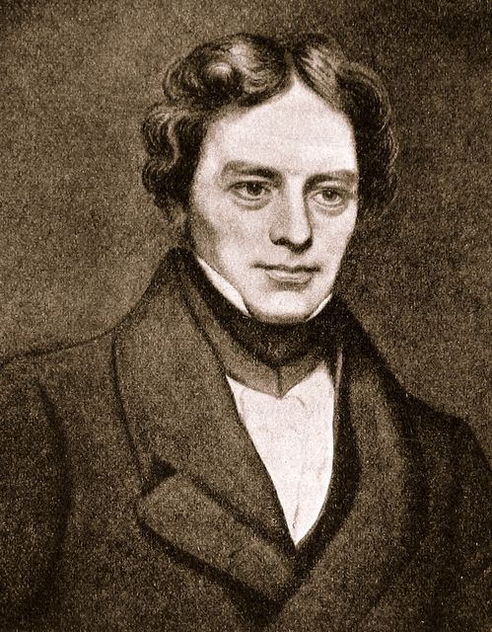
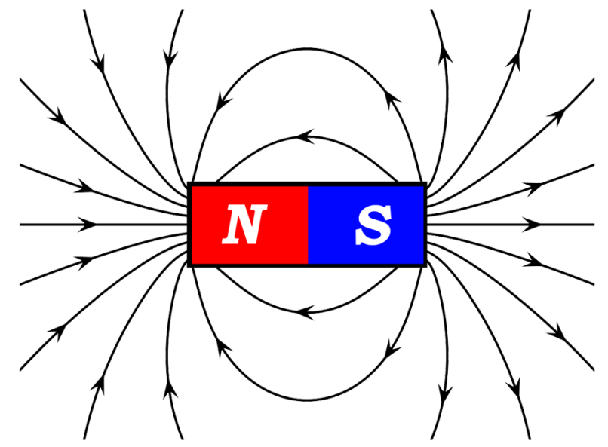
ELECTROMAGNETIC
INDUCTION
MICHAEL FARADAY
(1931)

Slide 6
ELECTROMAGNETIC
INDUCTION
The process by which a changing magnetic field in a conductor induces a current in another conductor, is called Electromagnetic Induction.
Hence, we conclude that
Motion of the magnet with respect to the coil produces an induced potential difference which sets up an induced electric current in the circuit.
N
S
S
N
The direction of induced current depends on,
0
(i) Direction of motion of conductor.
10
10
20
20
(ii) Direction of magnetic field.
G

Slide 7


Fleming’s Right Hand Rule
Stretch the thumb, the forefinger and the middle finger of the right hand in such a way that they are perpendicular to each other.
Motion of a conductor
Thumb
If
thumb is in the direction of motion of the conductor,
forefinger is in the direction of the magnetic field,
Then the middle finger shows the direction of the induced current.
Forefinger
Direction of the magnetic field
Middle finger
Direction of induced current

Slide 8
Activity To Observe
Induced Current
Coil 1
Coil 2
+
−
.
0
10
10
)
(
20
20
G

Slide 9
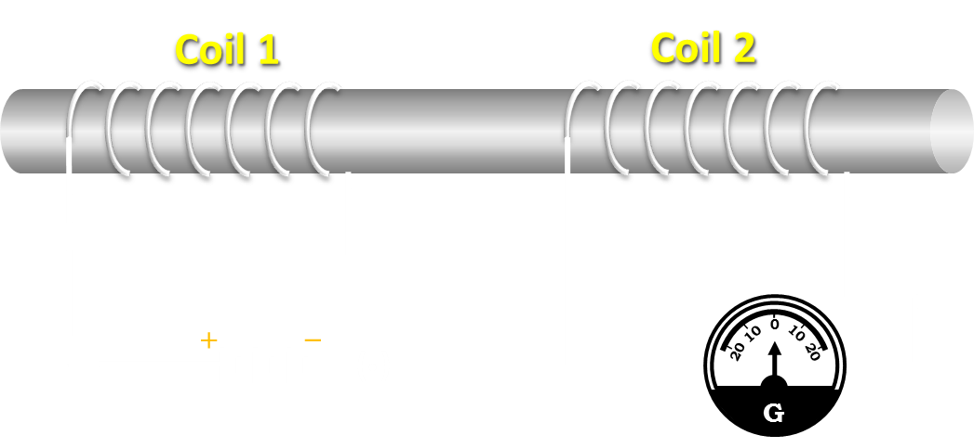
Activity To Observe
Induced Current
(i) What do you observe when you switch on the current in coil 1, i.e. when you connect coil 1 to the battery?
Ans: when coil 1 is connected to the battery, we observe deflection in the galvanometer connected to coil 2.
(ii) What do you observe when current in coil 1 reaches a steady value or zero?
Ans: When the current in coil 1 reaches a steady value or becomes zero, there is no deflection in the galvanometer.
(iii) Why is current induced in coil 2 when we connect coil 1 to a battery?
Ans: When we connect the coil to the battery, current starts flowing, hence there is a change is the magnetic field. This change in magnetic field induces a current in coil 2 the process by which changing magnetic field induces a current in another conductor is called electromagnetic induction.

Slide 10
Observe the figure. If the current in the coil A is changed, will some current be induced in the coil B? Explain.
A
B
G
+
-
If the current in coil A is changed, then some current will be induced in coil B.
As the current in coil A changes, the magnetic field related to it also change.
Due to the changing magnetic field. Current is induced in coil B.

Slide 11
Explain different ways to induce current in a coil.
Or
List two different ways of induced current in a coil.
Q.
Ans.
A current can be induced in a coil by
moving a magnet towards or away from the coil or vice versa, and
Changing current in the neighboring coil.

Slide 12
Thank You

